Slide 1


Analog Electronics Fundamentals 101
-Voltage, Resistance & Current
-Ohm's Law
-Resistors
-Direct Current (DC)
-Lab1: Taste the Power!
-Lab2: Your first circuit

Slide 2
1 VOLTAGE, CURRENT, AND RESISTANCE
Voltage (unit: volt, constant: V, symbol: V)
Voltage is the change in electric potential between two points. Voltage is always measured between two points, for example between the positive and negative ends of a battery, or between a wire and ground.
Current (unit: ampere or amp, constant: I, symbol: A)
Current is the rate of flow of electric charge past a point. Current is always measured at a single point.
Resistance (unit: ohm, constant: R, symbol: Ω)
Electrical resistance is the repulsion of a current within a circuit. It explains the relationship between voltage (amount of electrical pressure) and ampere (amount of electrical current).

Slide 3
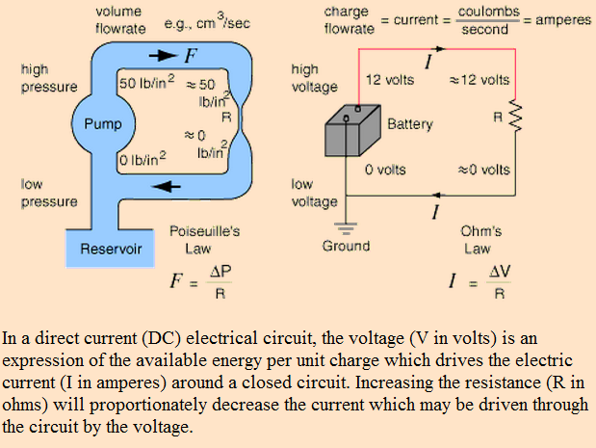
1.1 DC Circuit Water Analogy
Source: http://hyperphysics.phy-astr.gsu.edu/hbase/electric/watcir.html

Slide 4
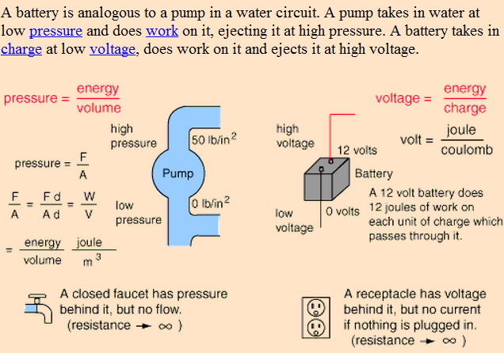
1.2 Voltage – Pressure Analogy
Source: http://hyperphysics.phy-astr.gsu.edu/hbase/electric/watcir.html

Slide 5
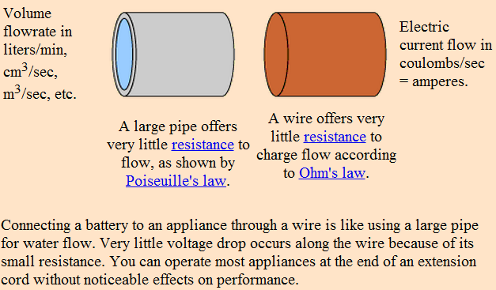
1.3 Current – Flowrate Analogy
Source: http://hyperphysics.phy-astr.gsu.edu/hbase/electric/watcir.html

Slide 6
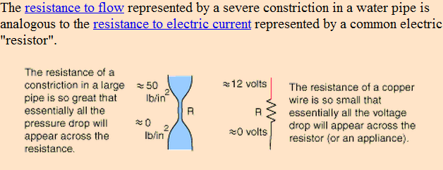
1.4 Resistance to Flow Analogy
Source: http://hyperphysics.phy-astr.gsu.edu/hbase/electric/watcir.html

Slide 7

2 Ohm’s Law
Ohm's law says that in an electrical circuit, the current passing through resistor between two points, is related to the voltage difference between the two points, and inversely related to the electrical resistance between the two points. This relation is shown in the following formula:

Slide 8
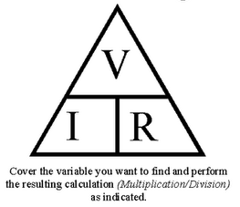
2.1 Ohm’s Triangle

Slide 9
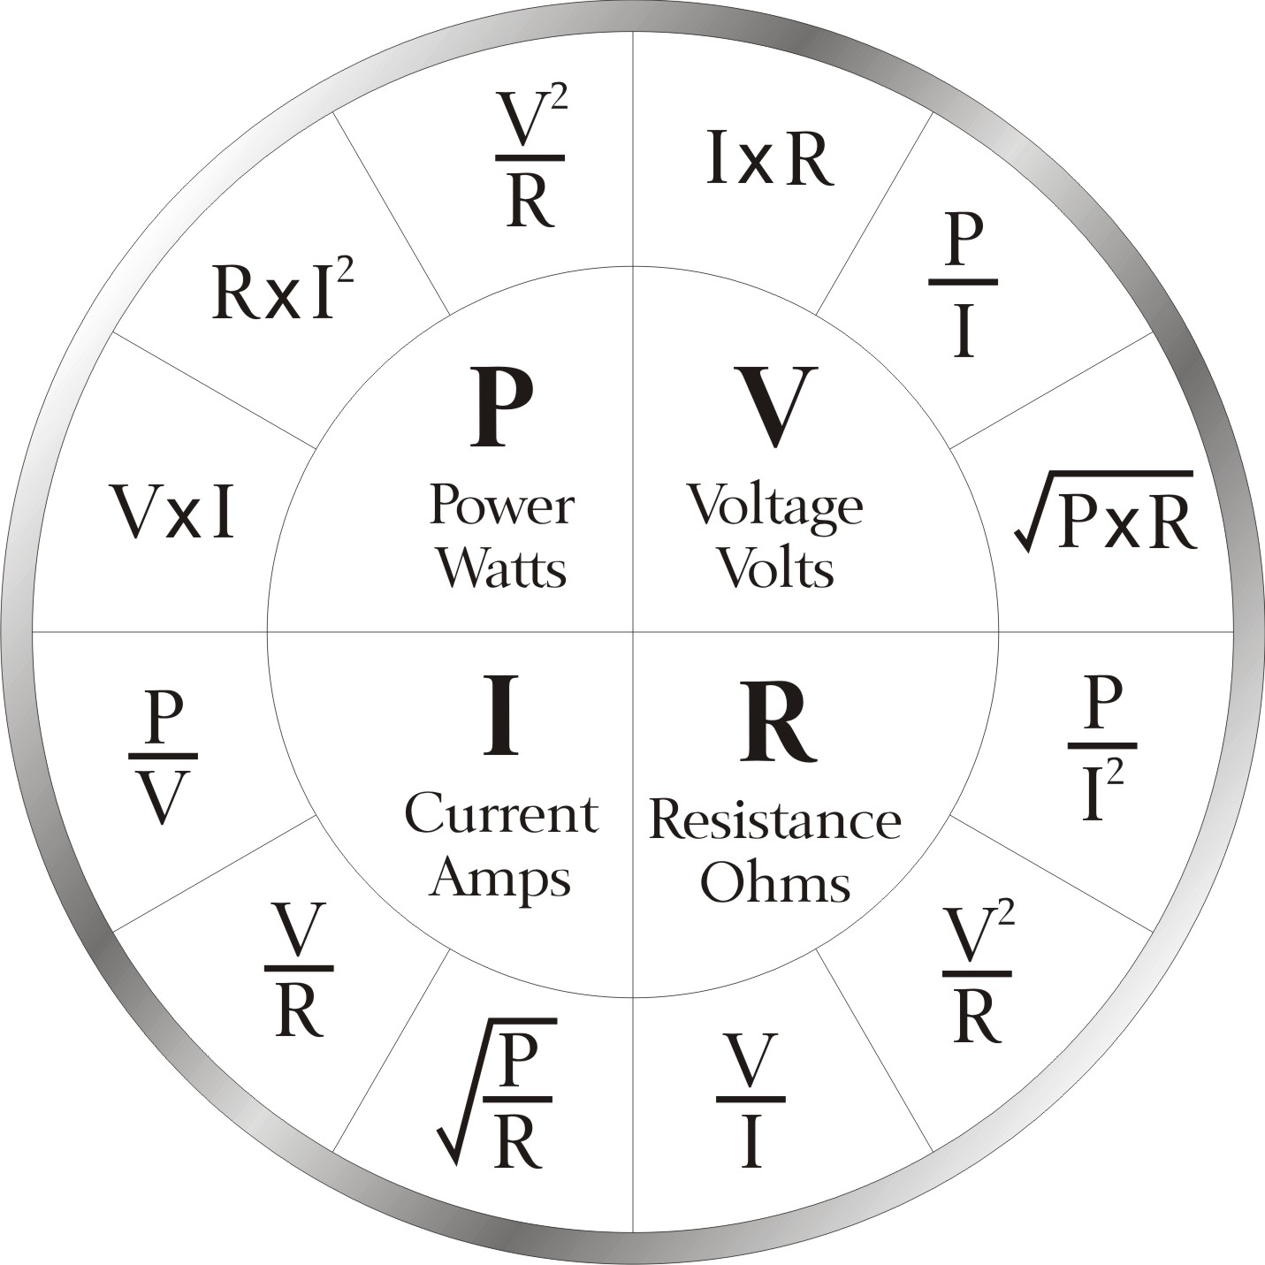
2.2 Ohm’s Law and Power

Slide 10
3 Resistors
A resistor is a passive two-terminal electrical component that implements electrical resistance as a circuit element. The current through a resistor is in direct proportion to the voltage across the resistor's terminals. Thus, the ratio of the voltage applied across a resistor's terminals to the intensity of current through the circuit is called resistance.

Slide 11
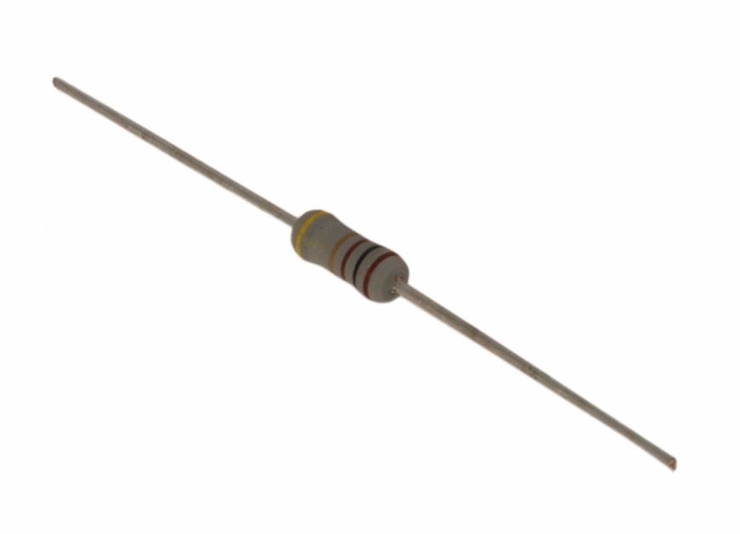
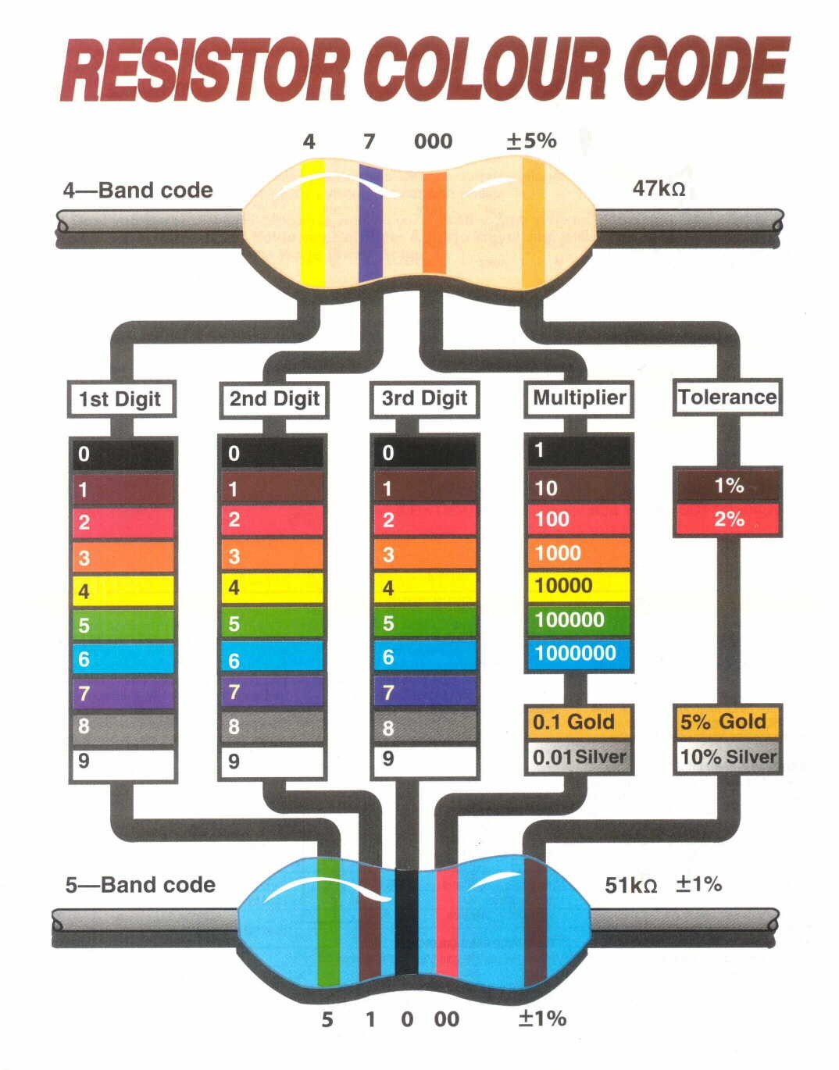
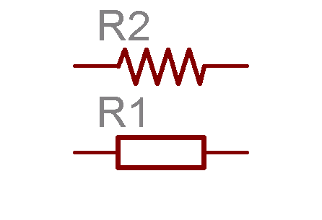
3.1 Resistors

Slide 12
4 DC (Direct Current)
Direct current (DC) is the unidirectional flow of electric charge. Direct current is produced by sources such as batteries, thermocouples and solar cells. Direct current may flow in a conductor such as a wire, but can also flow through semiconductors, insulators, or even through a vacuum as in electron or ion beams. The electric charge flows in a constant direction, distinguishing it from alternating current (AC).

Slide 13
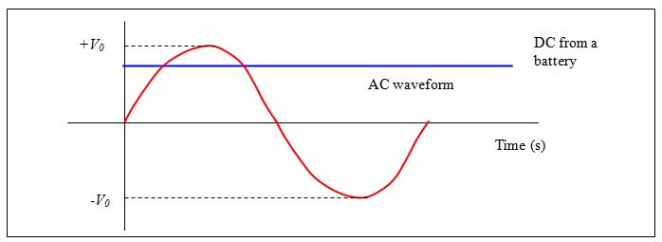
4.1 DC vs AC

Slide 14
4 Lab 1: Taste the Power!
** This lab was taken from the book “Make: Electronics” **
Moisten your tongue and touch the tip of it to the metal terminals of a 9-volt battery. The sudden sharp tingle that you feel is caused by electricity flowing from one terminal of the battery, through the moisture on and in your tongue, to the other terminal. Because the skin of your tongue is very thin and the nerves are close to the surface, you can feel the electricity very easily.
Now stick out your tongue, dry the tip of it very thoroughly with a tissue, and repeat the experiment without allowing your tongue to become moist again.
What’s happening here? We’re going to need a meter to find out.

Slide 15
4.1 Lab 1: Taste the Power!
Multimeter Setup:
Most meters have removable wires, known as leads (pronounced “leeds”).
Most meters also have three sockets on the front, the leftmost one usually being reserved to measure high electrical currents. We can ignore that one for now.
The leads will probably be black and red. The black wire plugs into a socket labeled “COM” or “Common.”
Plug the red one into the socket labeled “V” or “volts.”
If your meter doesn’t do autoranging, each position on the dial will have a number beside it. This number means “no higher than.” For instance if you want to check a 6-volt battery, and one position on the voltage section of the dial is numbered 2 and the next position is numbered 20, position 2 means “no higher than 2 volts.” You have to go to the next position, which means “no higher than 20 volts.”

Slide 16
4.2 Lab 1: Taste the Power!
We’re going to use the meter to discover the electrical resistance of your tongue.
First, set your meter to measure resistance. If it has autoranging, look to see whether it is displaying a K, meaning kilohms, or M, meaning megaohms.
If you have to set the range manually, begin with no less than 100,000 ohms (100K).
Touch the probes to your tongue, about an inch apart. Note the reading, which should be around 50K.
Now put aside the probes, stick out your tongue, and use a tissue to dry it very carefully and thoroughly.
Without allowing your tongue to become moist again, repeat the test, and the reading should be higher.
Finally, press the probes against the skin of your hand or arm: you may get no reading at all, until you moisten your skin.

Slide 17
5 Lab 2: Your first circuit!
** This lab was taken from the book “Make: Electronics” **
You will need:
9v Battery battery. Quantity: 1.
9v Battery Socket & leads. Quantity: 1.
Resistors: 470Ω, 1K, and either 2K or 2.2K (the 2.2K value happens to be more common than 2K, but either will do in this experiment). Quantity: 1 of each resistor.
An LED, any type. Quantity: 1.
Alligator clips. Quantity: 3.

Slide 18
5.1 Lab 2: Your first circuit!
Now take a look at one of your LEDs. An old-fashioned lightbulb wastes a lot of power by converting it into heat. LEDs are much smarter: they convert almost all their power into light, and they last almost indefinitely—as long as you treat them right! An LED is quite fussy about the amount of power it gets, and the way it gets it. Always follow these rules:
The longer wire protruding from the LED must receive a more positive voltage than the shorter wire.
The voltage difference between the long wire and the short wire must not exceed the limit stated by the manufacturer.
The current passing through the LED must not exceed the limit stated by the manufacturer.
What happens if you break these rules? Well, we’re going to find out!

Slide 19
5.2 Lab 2: Your first circuit!
Make sure you are using fresh batteries. You can check by setting your multimeter to measure volts DC, and touching the probes to the terminals of each battery. You should find that each of them generates a pressure of at least 9 volts. If they read slightly higher than this, it’s normal. A battery starts out above its rated voltage, and delivers progressively less as you use it. Batteries also lose some voltage while they are sitting on the shelf doing nothing.
Now select a 2.2KΩ resistor. Remember, “2.2KΩ” means “2,200 ohms.” If it has colored stripes, they should be red-red-red, meaning 2-2 and two more zeros.
Wire it into the circuit as shown in Figure 1-45. You should see the LED glow very dimly.

Slide 20
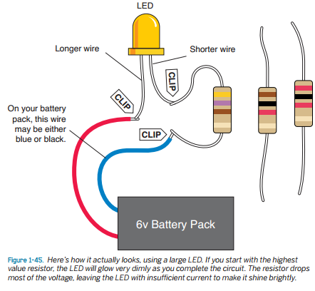
5.2 Lab 2: Your first circuit!
Now swap out your 2.2K resistor and substitute a 1K resistor, which will have brown-black-red stripes, meaning 1-0 and two more zeros. The LED should glow more brightly.
Swap out the 1K resistor and substitute a 470Ω resistor, which will have yellow-violet-brown stripes, meaning 4-7 and one more zero. The LED should be brighter still.
This may seem very elementary, but it makes an important point. The resistor blocks a percentage of the voltage in the circuit. Think of it as being like a kink or constriction in a flexible hose. A higher-value resistor blocks more voltage, leaving less for the LED.

